Slide 1
Input and Output in C Programming
Presented By:
Md. Tanvir Hasan
Md. Shakib Salim Tonmoy
Tisha Das
Aishwarja Joydhor K.M Sahaaf
Presented to, Md Mahbub E Nur
Sir

Slide 2
Introduction
What is Input and Output in C Programming?
Input: Accepting data from the user.
Output: Displaying the results of processing data.

Slide 3
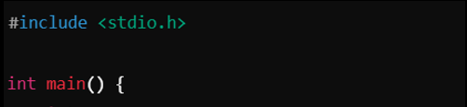
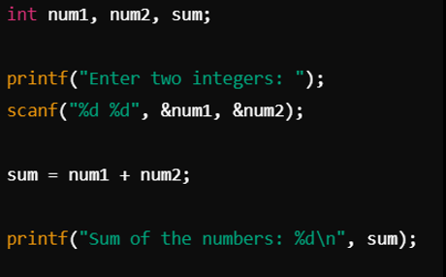

Tells Compiler to include Header File
Starting Point of a Program
Main Code
This is the main programming.
It takes two integers from user.
Doing an Arithmetic Operation
Display the summation of the two integers
Return 0 indicates the program executed successfully
Closing Brace

Slide 4
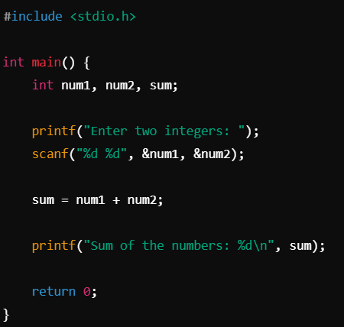
Declares two integer to store user input.
Displays a message asking the user to provide input.
Reads two integers entered by the user and stores them in num1 and num2

Slide 5
Explanation of scanf
%d specifies the data type (integer)
expected from the user
& operator passes the memory address
of the variables to store the input values.

Slide 6


Example Execution
User Input: 4 6
Stored Values:
num1 = 4
num2 = 6
?

Slide 7
?

Slide 8

The program calculates the sum of the two integers entered by the user.
The result is stored in the variable sum.

Slide 9
Key Concept: This is a simple arithmetic operation performed by the program to process the input data.
Variable Input
Arithmetic Operation
?
Displaying result

Slide 10



Displaying result

Slide 11
Structure of that Code
Md Tanvir Hasan
Taking Input
Md. Shakib Salim Tonmoy
KM Sahaaf
Arithmetic Operation
Tisha Das
Aishwarha Joydhor
Some Example of C Input Output
Display Output

Slide 12
Start
Declare Variable
Prompt for User Input
Read Input
Calculate Summation
Print Summation
End

Slide 13
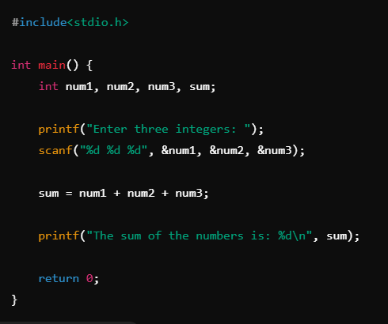
Start
Declare Variable
Prompt for User Input
Read Input
Calculate Summation
Print Summation
End

Slide 14
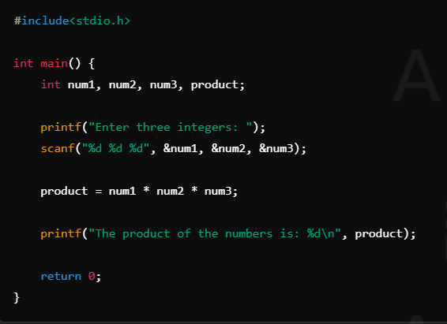
Start
Declare Variable
Prompt for User Input
Read Input
Calculate Multiplication
Print Summation
End

